Slide 1
Future Floating Mission
Topic
For bigger spacecraft capable of executing bigger missions, some of the assembly may be done in space. Our challenge is to design a simple approach that enables components to be assembled in space.

Slide 2
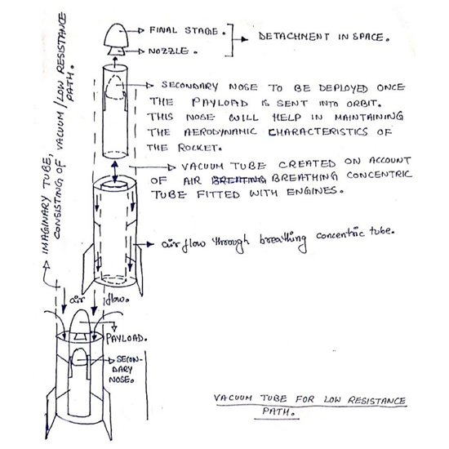
Vacuum tube for Low Resistance Path
At the velocity of rocket, the breathing tube will suck in air in front of it through ram compression and expel out with a greater velocity through nozzle thereby giving the extra boost for propulsion in addition to the boost from SRBs .The onboard instrument will monitor the density change in the atmosphere given by the formula ρ≈ρ_{o}e^{-h/Hn} where Hn is the scale height. Scale Height is the distance over which the density falls by a factor of 1/e.
On entering the ionosphere and subsequently the mesosphere, the concentric tube will be given a potential difference with respect to so as to act as a minimum straight particle accelerator to shift to ion propulsion system.
The final stage will see the use of Beacons from all the individual payload from such rockets and through phase maneuvers with the use of ORMs can be used of Docking Mechanism.

Slide 3
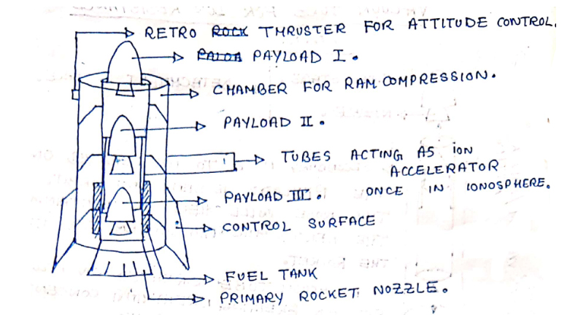
Payloads in rocket
Depending upon the number of payloads to be sent into orbit, the length of the rocket can be designed. The payload deployment will occur in steps whose data can be sent to monitor the deployment of the next payload into a suitable perigee radius. Apart from the normal use of SRBs, ion propulsion coupled with the air breathing engine is utilized in the contrast to the conventional approach to SRBs. The eccentric cylinder arrangement helps in creating a vacuum in the rocket’s path in order to minimize the air/atmospheric resistance.
The air breathing engines suck the incoming air by increasing the velocity, thereby creating a pressure difference between the inside of the concentric tube and just above the nose which results in air gushing in, thereby creating partial vacuum, resulting in low resistance path for rocket.
This update of carrying multiple payloads for deployment in one trip can save a significant amount of time for space assembly.

Slide 4
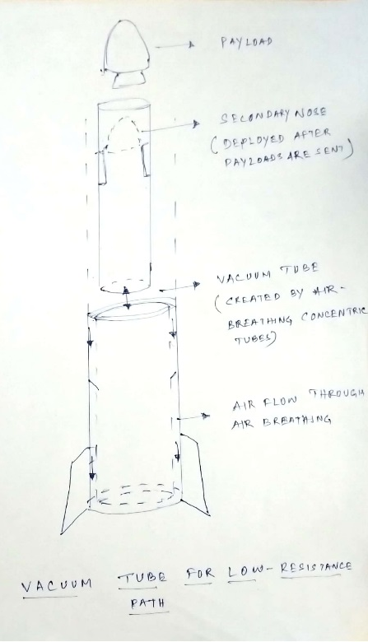
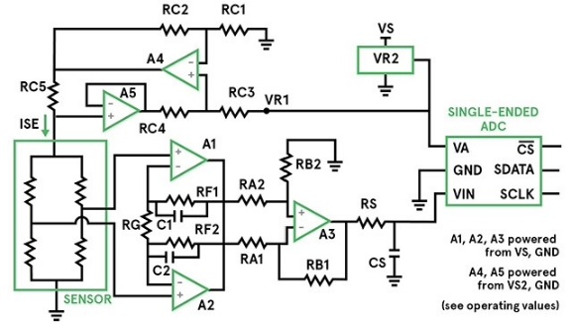
Feedback Control General Outline and Sensors Actuating
The sensors from the rocket 1 (R1) will calculate and relay the data like distance, altitude etc. as an output signal to the trailing rocket (R2) , which will follow the output signal from R1, which becomes the input signal for R2, and actuate the sensors like
proximity sensors according to the feedback to maintain the proximity, critical distance and track via feedback control method.
The air pressure will be determined by the on-board sensors in the rocket post detachment of the payload delivery. According top the air pressure exerted on the returning capsule, the sensors will translate the data for actuating the half sphere (aerofoil) to protrude.
The differential pressure sensor will give you a comparative measurement between two points. Typically, the two pressures to be measured are applied to opposite sides of a single diaphragm. The deflection of the diaphragm, either positive or negative with respect to the resting state, determines the difference in pressure. Some industrial differential sensors actually use two separate absolute sensors, utilizing internal electronics to calculate and provide the difference in pressure to the control system.
An example circuit.
These are the basics of probable sensing we might be using.

Slide 5
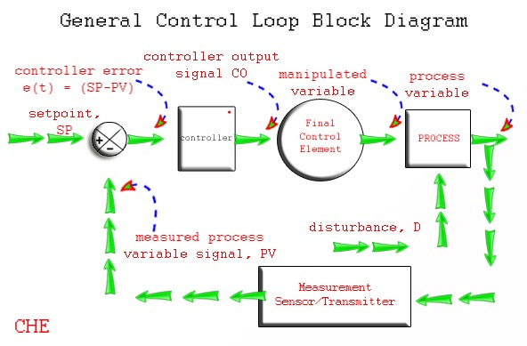
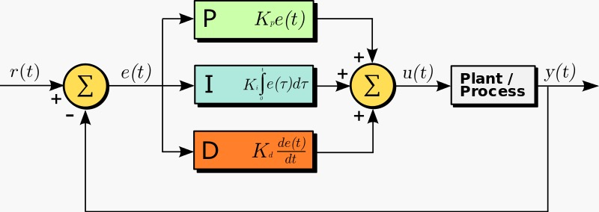
Control loop process and PID Feedback
A control loop is a process management system designed to maintain a process variable at a desired set point. Each step in the loop works in conjunction with the others to manage the system. Once the set point has been established, the control loop operates using a four-step process.
Sense
Compare
Respond
Affect
The loop continually cycles through the steps, affecting the process variable in order to maintain the desired set point.
PID Feedback Control- We can use the PID feedback control to ensure the minimization of errors in the loop.
These are the basics of the control system where we can integrate the sensor based systems.
Basic block diagram of PID feedback control

Slide 6
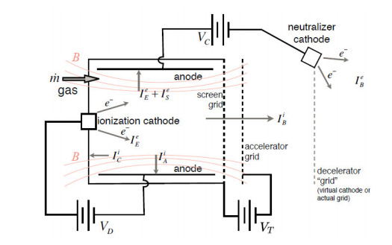
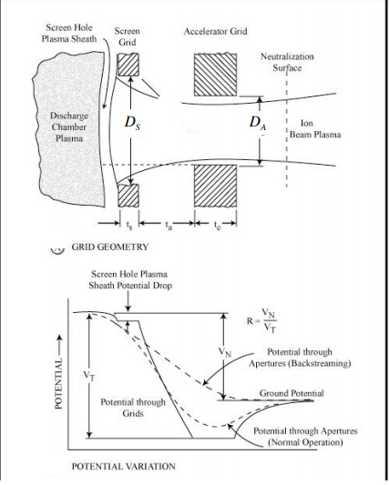
ION thrusters, ION Extraction and acceleration
Principles of Operation of ION thrusters (Kaufman
Ion Engines)-
Electrostatic thrusters accelerate heavy charged
atoms (ions) by means of a purely electrostatic
field. Magnetic fields are used only for auxiliary
Purposes in the ionization chamber. It is well
known that electrostatic forces per unit area
(or energies per unit volume) are of the order
of ½*ε_{o}E², where E is the strength of the
field (V/m).
Kaufman Ion Engine circuit
The geometry of the region around an aligned pair of screen and accelerator holes is shown schematically next. The electrostatic field imposed by the strongly negative accelerator grid is seen to penetrate somewhat into the plasma through the screen grid holes. This is fortunate, in that the concavity of the plasma surface provides a focusing effect which helps reduce ion impingement on the accelerator.
The result is an array of hundreds to thousands of individual ion beamlets, which are neutralized a short distance downstream, as indicated.
Ion Extraction and acceleration

Slide 7

The potential diagram on the last slide shows that the screen grid is at somewhat lower potential than the plasma in the chamber.
Child-Langmuir’s law:
References:
https://ocw.mit.edu/courses/aeronautics-and-astronautics/16-522-space-propulsion-spring-2015/lecture-notes/MIT16_522S15_Lecture10-11.pdf
Fundamentals of Electric Propulsion: Ion and Hall Thrusters by Dan M. Goebel and Ira Katz,Jet Propulsion Laboratory, California Institute of Technology https://descanso.jpl.nasa.gov/SciTechBook/series1/Goebel__cmprsd_opt.pdf
https://cds.cern.ch/record/1100534/files/p73.pdf
https://www.eecs.umich.edu/courses/eecs571/reading/control-to-computer-zaher.pdf
https://en.wikipedia.org/wiki/Control_theory
http://www.formula1-dictionary.net/drag.html
Fundamentals of Astrodynamics and Applications by David Wallado - https://books.google.co.in/books?id=PJLlWzMBKjkC&printsec=frontcover#v=onepage&q&f=false
Thank-you

